Slide 1
Introduction to Set Theory

Slide 2
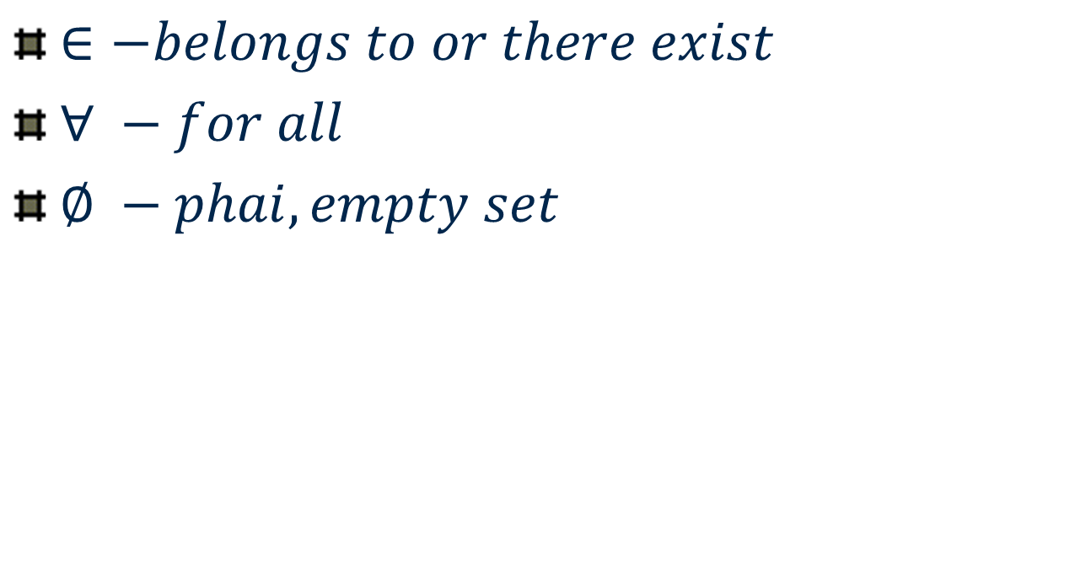
Symbols

Slide 3
Sets
Definition. A Set is any well defined collection of “objects.” Denoted by capital letters A, B, ..
Definition. The elements of a set are the objects in a set. Usually denoted by small letters or numerical values
Notation. Usually we denote sets with upper-case letters, elements with lower-case letters. The following notation is used to show set membership
means that x is a member of the set A
means that x is not a member of the set A.

Slide 4
Equal Sets
Two sets are said to be equal if they have same elements, say A = B
Eg. A = {a, b, c}, B = {c, b, a} => A = B
But A = {a, b, c} and B = {1, 2, 3, 4} => A ≠ B
Order does not matter in sets
A = { a, b, c} = {c, b, a} = {c, a, b}

Slide 5
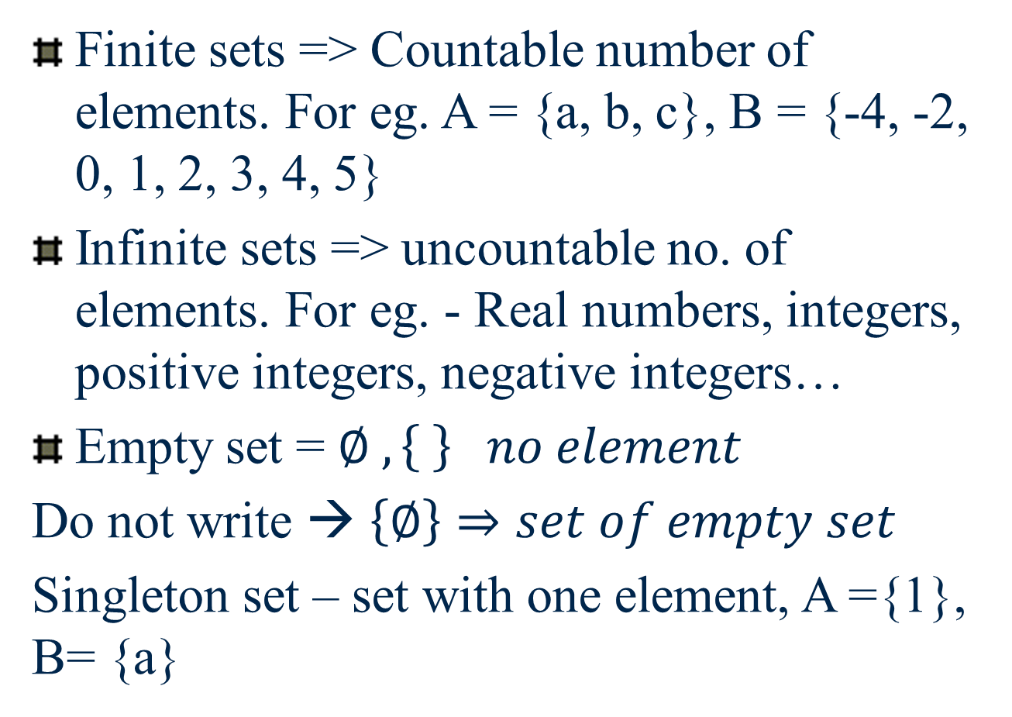
Types of Sets

Slide 6
Some Special Sets
The Null Set or Empty Set. This is a set with no elements, often symbolized by { } – empty set {ϕ}- wrong
The Universal Set. This is the set of all elements currently under consideration, and is often symbolized by U
Let A be the set of positive integers. Universal set will be the set of integers. U = {…., -2,-1, 0, 1, 2, …..}
A = { 0, 1, 2, ….}

Slide 7
Cardinality or Size of a set
For a finite set S, cardinality or size of set S is the number of elements present in S. If S contains n elements then it is defined as:
|S| = n
Eg. A = {1, 2, 3, …, 9}, |A| = 9
S = {x: x is an alphabet},
S = {x = A, x = B, ….., x = Z}
S = { A, B, C, …, Z} |S| = 26

Slide 8
Ways of Describing Sets
List the elements
Give a verbal description
“A is the set of all integers from 1 to 6, inclusive”
Give a mathematical inclusion rule

Slide 9
Set builder form
A = {1,2,3,4,5,6}
A = {x | 1≤ x ≤6, x is an integer}
x = 1, x = 2, x = 3, x =4, x = 5, x = 6
S = {x : x is root of 5x – 10 = 0} => x = 2
S = {2} --- singleton set
5x – 10 = 0 => 5x = 10 => x = 10/5 = 2
T = {x: x^2 – 5x + 6 = 0} => |T| = 2, why?
Coz, x^2 – 5x + 6 = 0 will have 2 solutions for x

Slide 10
Examples
2014 (N.S.)
1(a) Use suitable example to explain the tabular method of presenting a set.
Ans: Tabular method represents each and every member of set.
Eg. A = {1, 2, 3, 4, 5} B = {…, -3, -2, -1, 0, 1, 2, 3}

Slide 11
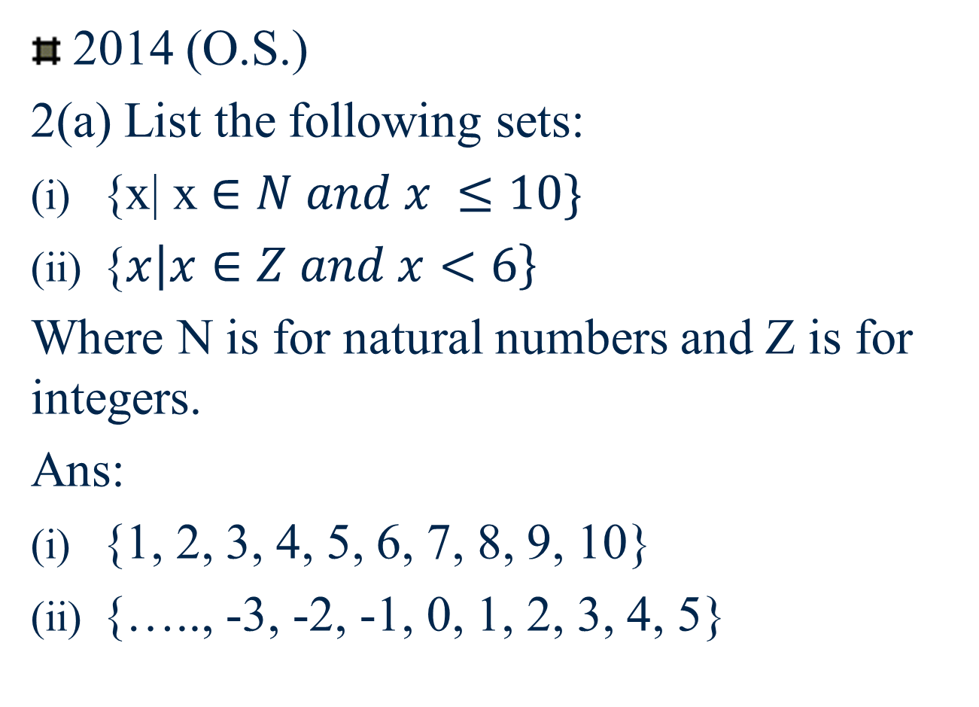

Slide 12
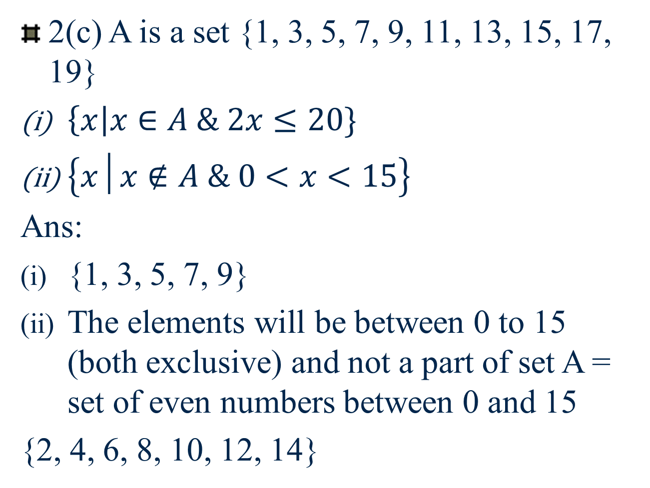

Slide 13
Combining Sets – Set Union
“A union B” is the set of all elements that are in A, or B, or both.
A = {1, 2, 3, 4} and B ={2,4,6,8}
AUB = {1,2,3,4,6,8}

Slide 14
Combining Sets – Set Intersection
“A intersect B” is the set of all elements that are in both A and B.
A = {1, 2, 3, 4} and B ={2,4,6,8}
AᴖB = {2,4}

Slide 15
Set Complement
“A complement,” or “not A” is the set of all elements not in A. OR A^{C}

Slide 16
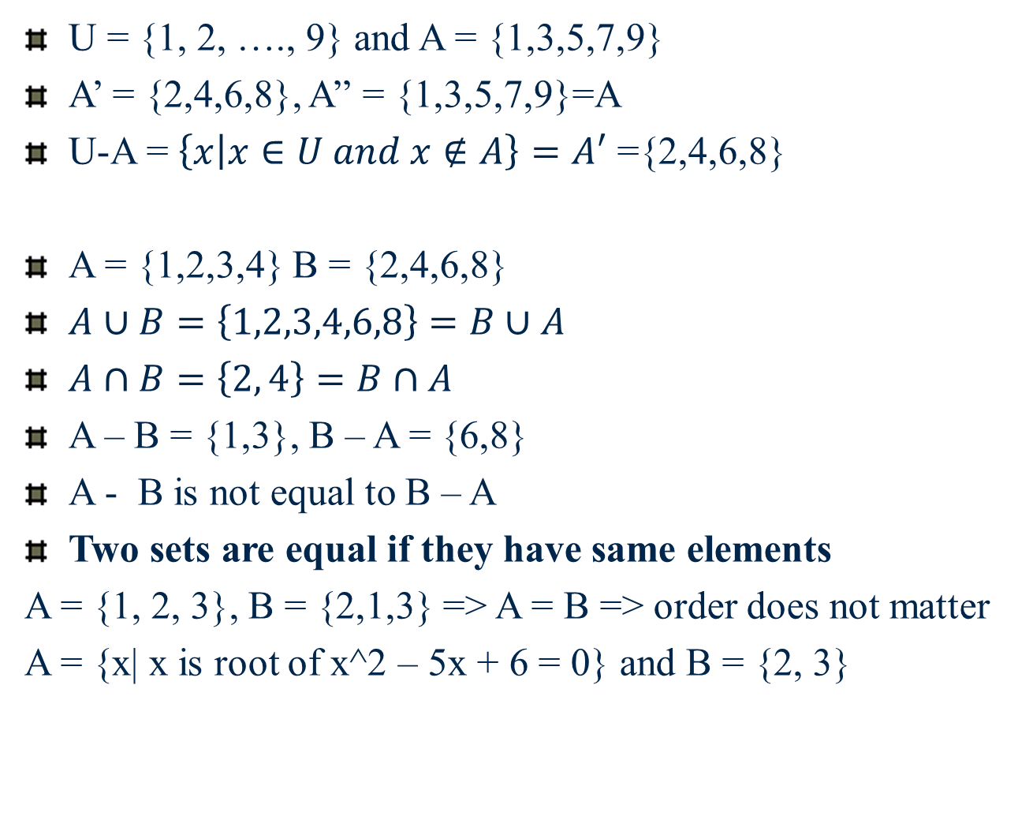

Slide 17

Set Difference
The set difference “A minus B” is the set of elements that are in A but not in B.

Slide 18
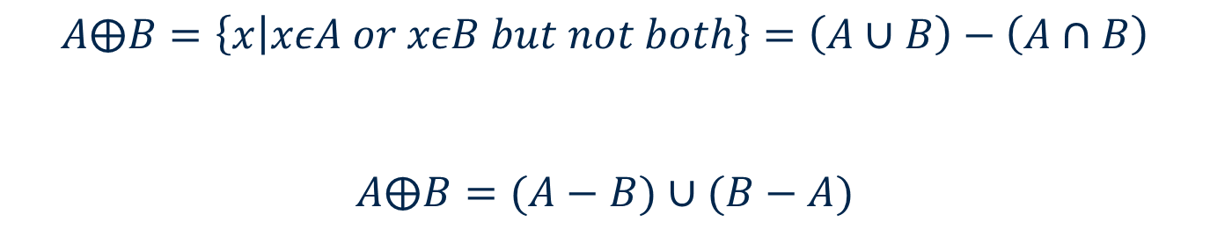
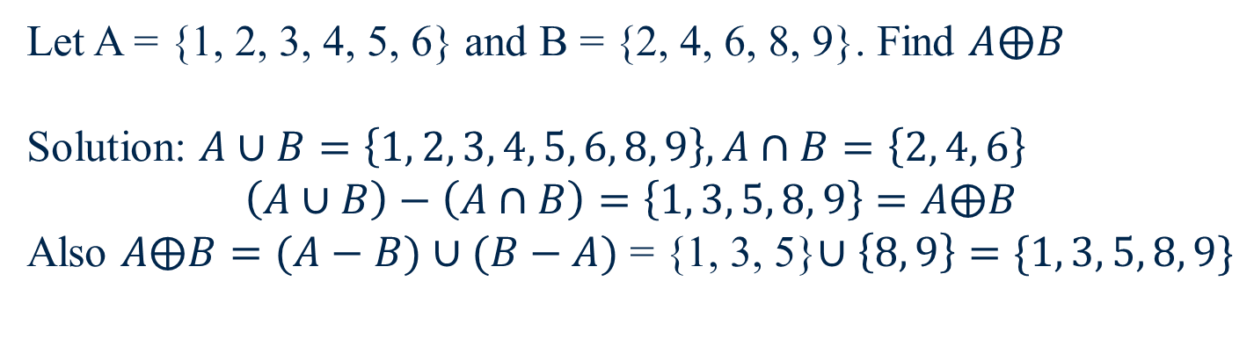
Symmetric Difference

Slide 19
Examples
A – B = {1, 2} = A∩B’
= U - B

Slide 20
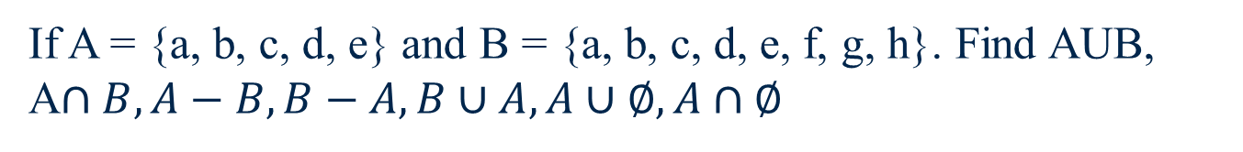
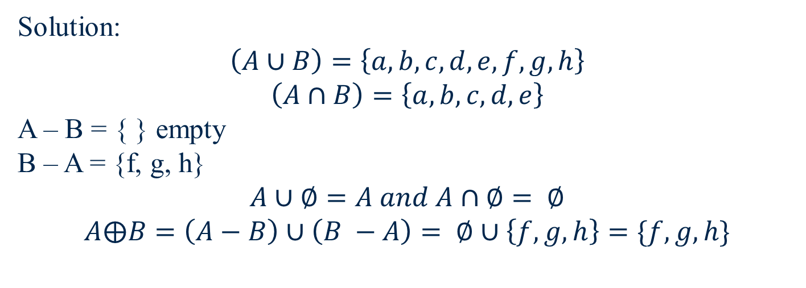

Slide 21
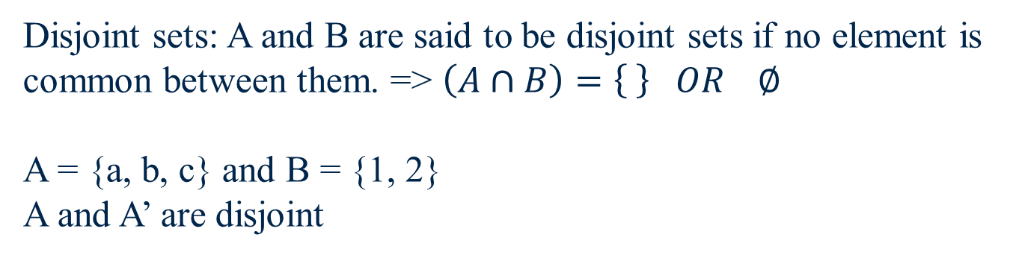
Disjoint Sets

Slide 22
Equal sets: Two sets A and B are equal if they have same elements. Eg.; A = {a, c, b} and B = { c, b, a} are equal. Hence order does not matter here in sets.
Equivalent sets: Two sets are equivalent if there is one-to-one correspondence between their elements. => no. of elements in A and B are same. Eg; A = {1, 2, 3, 4} B = {a, b, c,d} clearly A is not equal to B but A is equivalent to B (A ~ B)
A = {1, 4, 5, 7, 8}, B = {2, 3, 4, 5, 7}, C = {4, 5, 7}, D = {7, 5, 4} => C = D, A ~ B
2018(N.S.) Explain equal and equivalent sets.
2017 1(a) use suitable example to explain equal set.

Slide 23
2016.
Q2
Using suitable example explain and illustrate following:
(i) Disjoint sets (ii) intersection of two sets (iii) complement of a set (iv) Cartesian product (A x B)

Slide 24
Subsets
Definition. Subset.
“A is a subset of B”
We say “A is a subset of B” if , i.e., all the members of A are also members of B. The notation for subset is very similar to the notation for “less than or equal to,” and means, in terms of the sets, “included in or equal to.”

Slide 25
Proper Subsets
Definition. Proper Subset.
“A is a proper subset of B”
We say “A is a proper subset of B” if all the members of A are also members of B, but in addition there exists at least one element c such that but . The notation for subset is very similar to the notation for “less than,” and means, in terms of the sets, “included in but not equal to.”

Slide 26
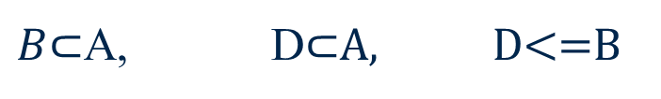
A
B and D are proper subsets of A. whereas D is an improper subset of B.
a, b, d, e, f
B
c, h, g
Note:- Every set has two improper subsets. => empty set and set itself

Slide 27
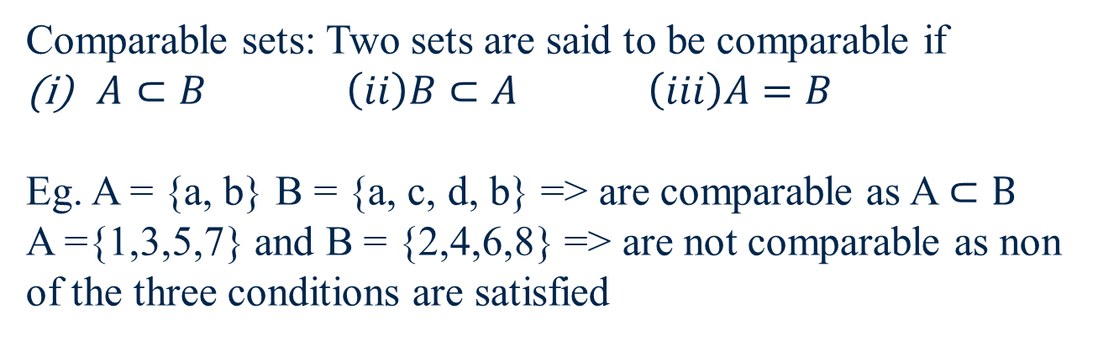

Slide 28
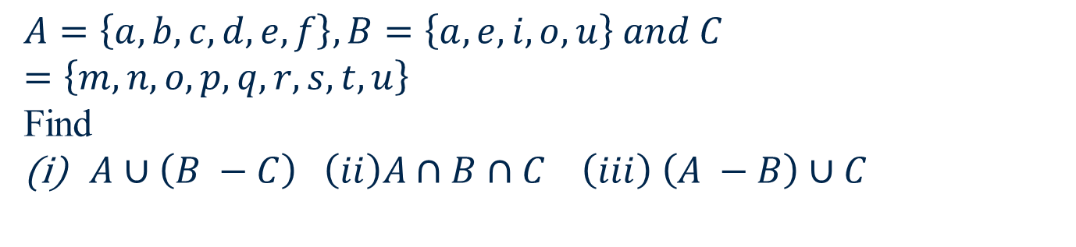

Slide 29
Venn Diagram
Universal Set U
A

Slide 30
Venn Diagrams
Venn Diagrams

Slide 31
Venn Diagrams
Try this one!

Slide 32
Venn Diagrams
Here is another one

Slide 33
A
B
B – A = only the elements of B

Slide 34
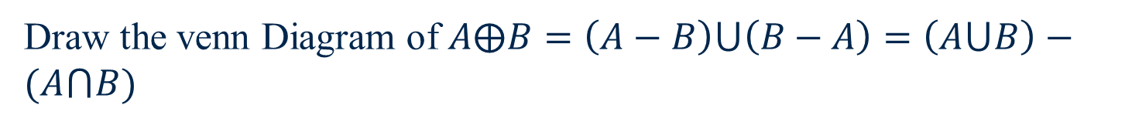
A
B

Slide 35

Draw Venn diagram for the followings:
A
B
C

Slide 36

A
B
C

Slide 37
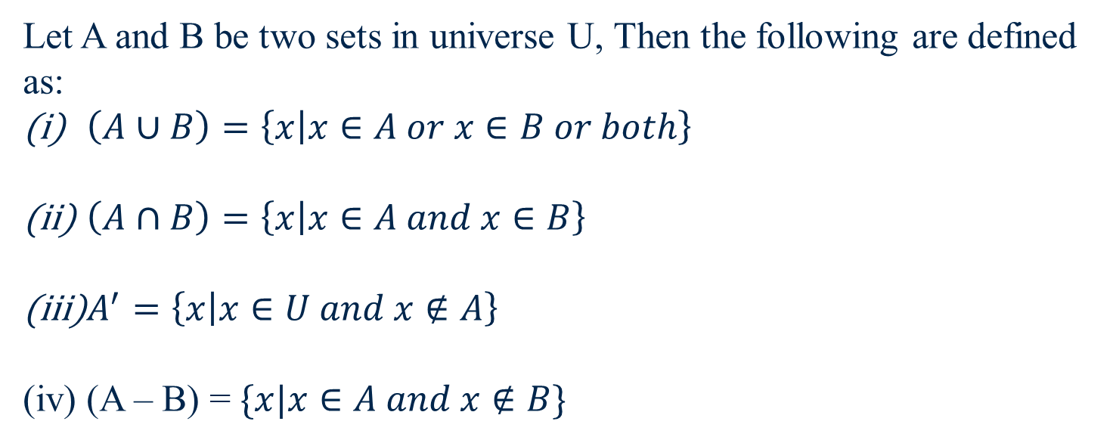
Set Operations

Slide 38
Set of Sets: S = { {2}, {3, 4}, {2, 5, 6} { }}
Elements : - {2}, {3, 4}, {2,5,6}, { } of set S.
Power Set: For any set S, power set P(S) is the set of all possible subsets of S. If |S| = n, power set will have 2^n elements.
Eg. S = {1, 2} => |S| = 2
Subsets of S
Improper subsets: { }, S = {1, 2}
Subsets with single element: {1}, {2}
P(S) = {{}, {1}, {2}, {1,2}} => |P(S)| = 4 = 2^2 = 2^|S|
A = {1, 2, 3} => |A| = 3 => subset can have 0, 1, 2, or 3 elements
Subset with 0 element = {}
Subsets with 1 element => {1}, {2} and {3}
Subsets with 2 elements => {1, 2}, {2, 3} and {1, 3}
Subsets with 3 elements => {1, 2, 3}
P(A) ={ {}, {1}, {2}, {3}, {1, 2}, {1, 3}, {2, 3}, {1, 2, 3}} => |P(A)| = 8 = 2^3 = 2^|A|

Slide 39

Find Power set of the following sets:
S = {1,2,3,4}
A = { {}, {1, 2}, 3}
Solution: (ii) A = { a, b, c} => a = {}, b = {1, 2} c = 3
P(A) = { { }, {a}, {b}, {c}, {a, b}, {a, c}, {b, c}, {a, b, c}}
= { {}, {{}}, {{1, 2}}, {3}, {{}, {1, 2}}, {{}, 3}, {{1, 2}, 3}, {{}, {1, 2}, 3} }

Slide 40
Find all possible subsets of A = {ϕ, {ϕ}, 1}
Solution: since |A| = 3, P(A) will have 2^3 = 8 possible elements.
Elements of P(A):
Φ, {ϕ}, {{ϕ}}, {1}, {ϕ, {ϕ}}, {ϕ, 1}, {{ϕ}, 1} , {ϕ,{ϕ},1}

Slide 41
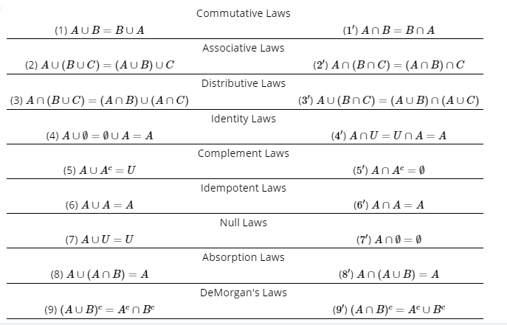

Slide 42
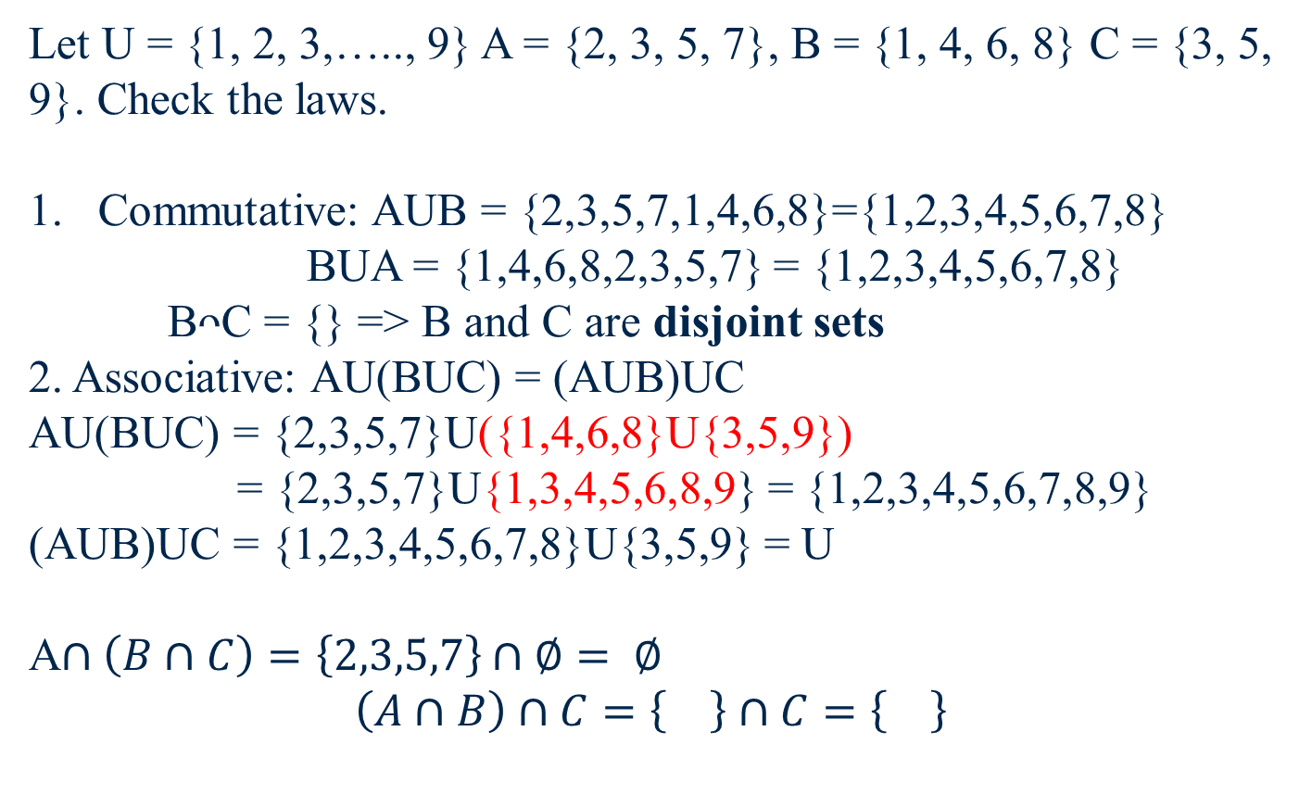
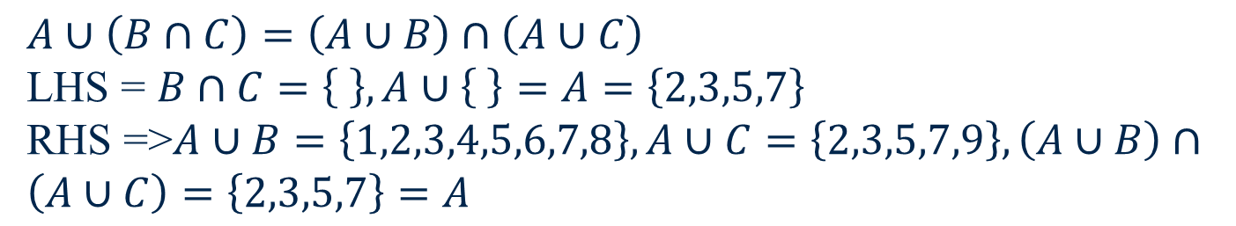

Slide 43
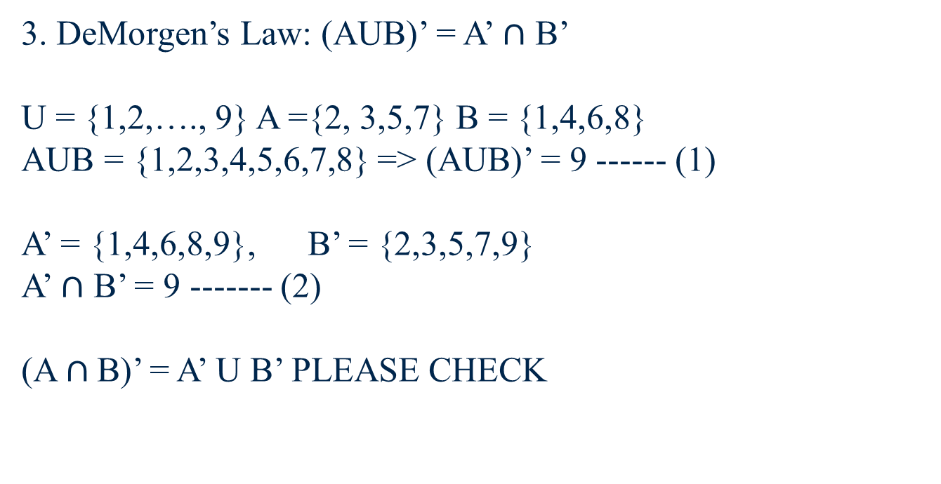
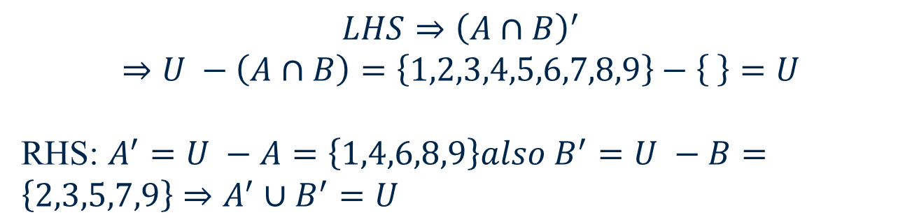

Slide 44
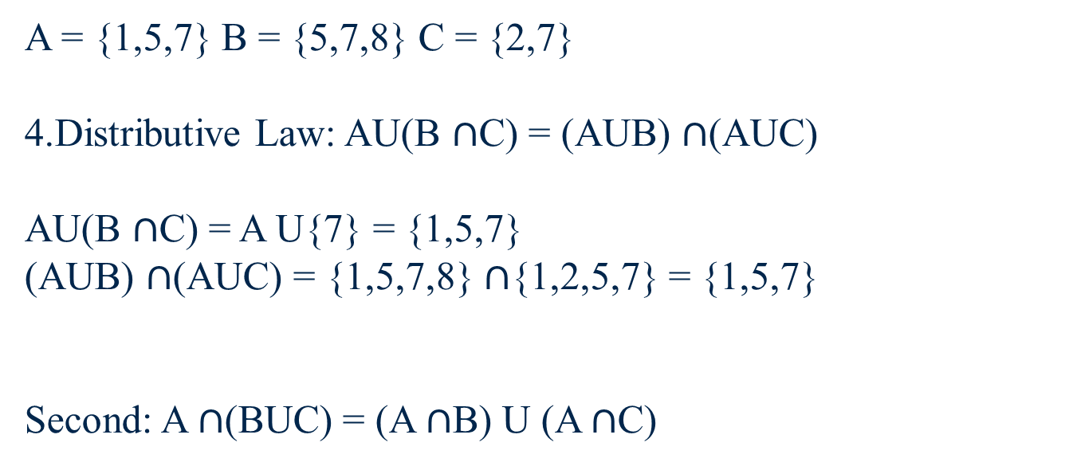

Slide 45
Venn Diagram for De’Morgan

Slide 46
A <= B and B <= A ➔ A = B
A = {2, 3} and B = {3, 2}
A is a subset of B => an element x in A is also in B
B is a subset of A => an element y in B is also in A
A = B

Slide 47
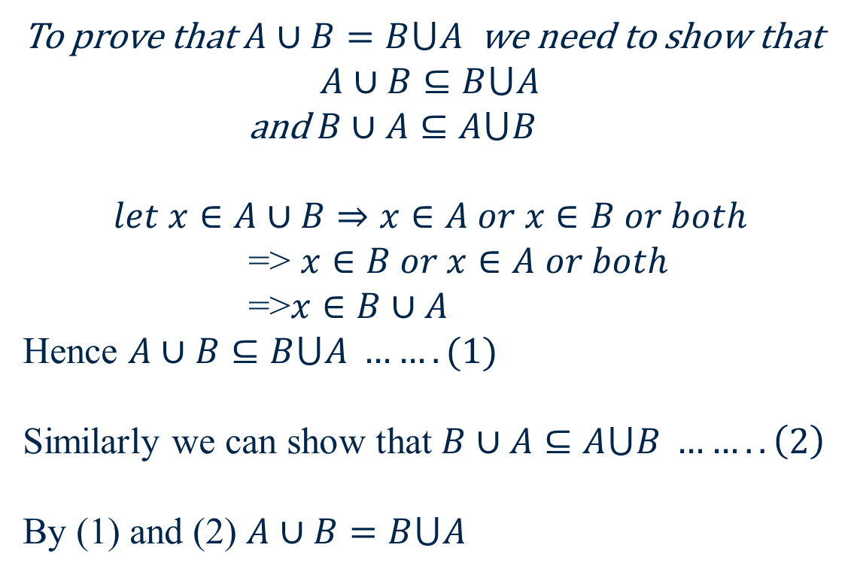
Prove Commutative law.

Slide 48
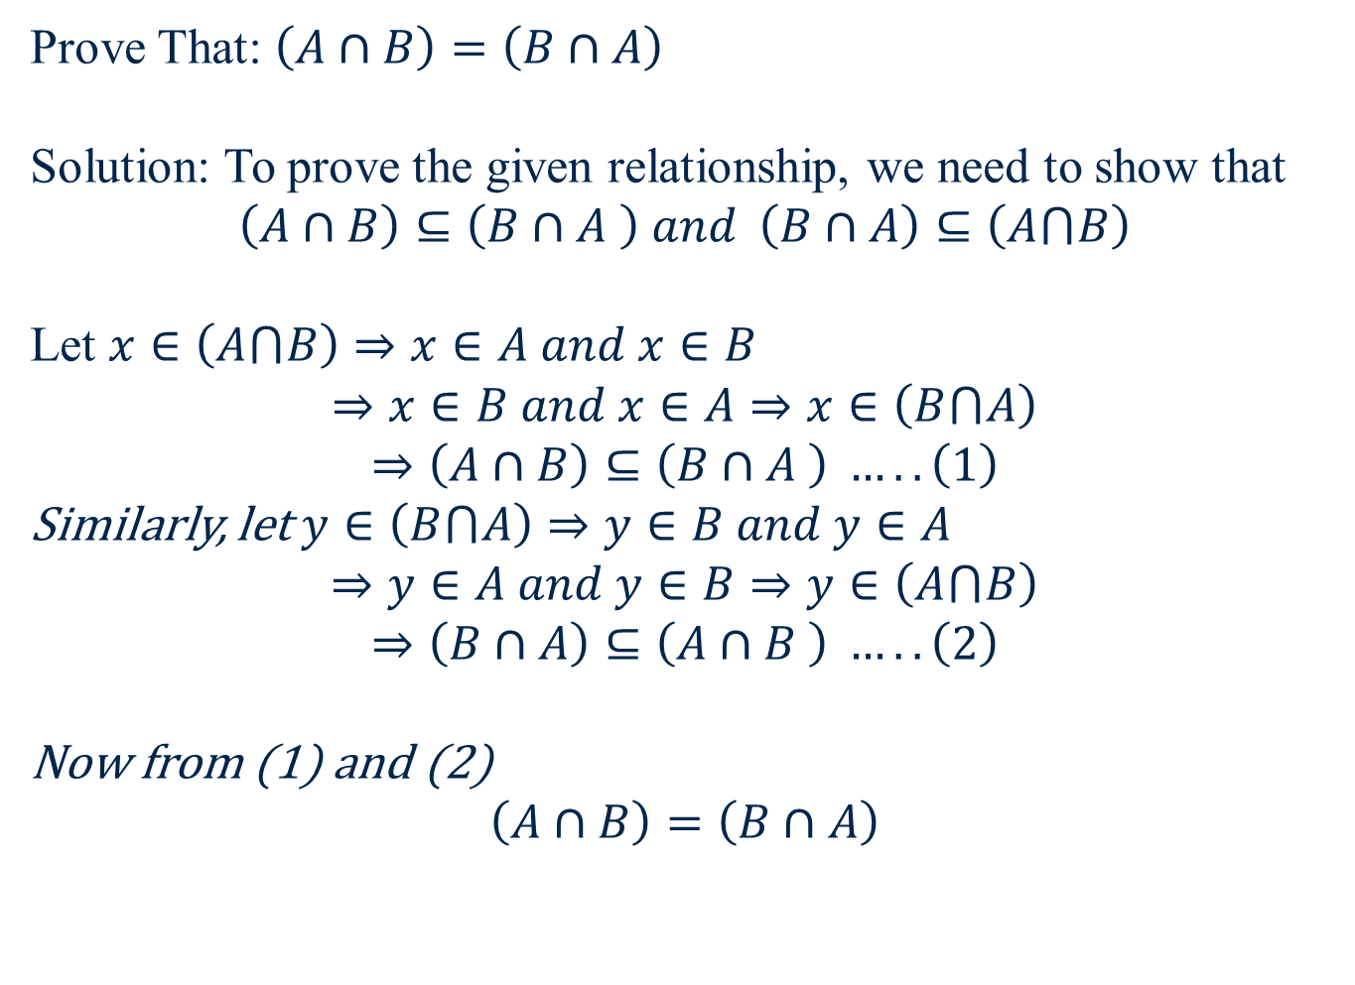

Slide 49
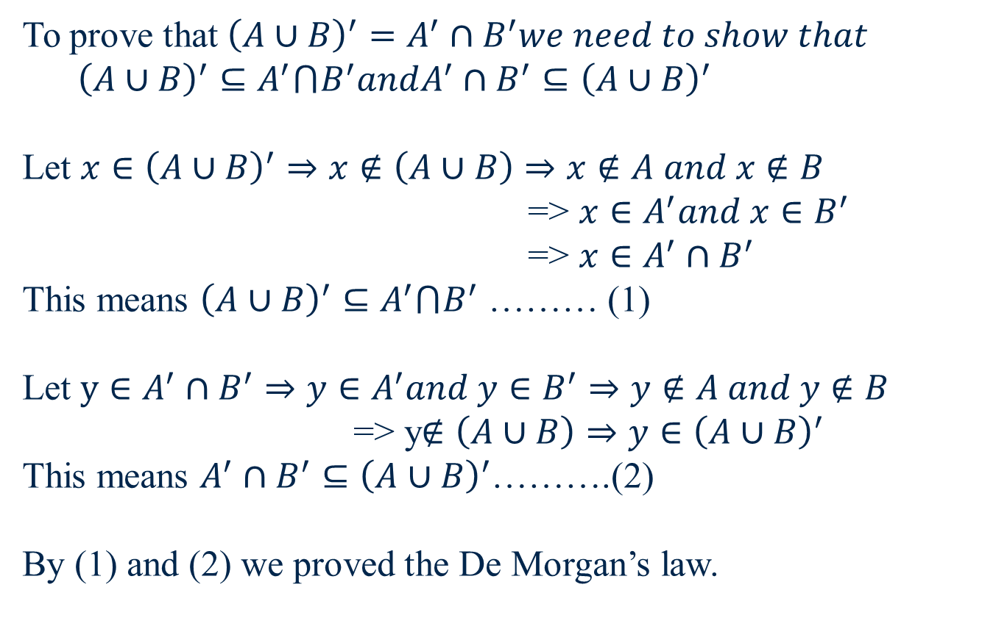
Prove De Morgan’s Law

Slide 50
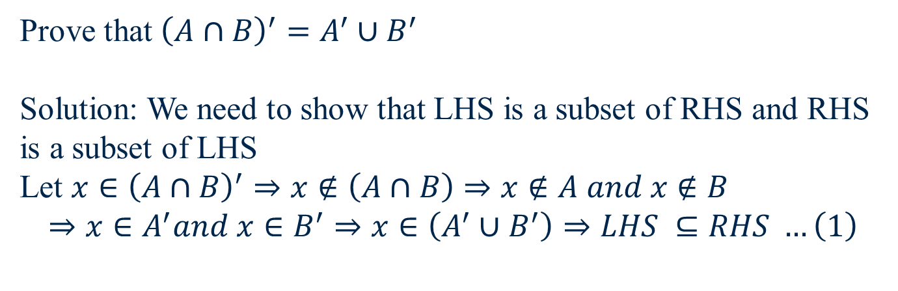

Slide 51
Mutually Exclusive and Exhaustive Sets
Definition. We say that a group of sets is exhaustive of another set if their union is equal to that set. For example, if we say that A and B are exhaustive with respect to C.
Definition. We say that two sets A and B are mutually exclusive if , that is, the sets have no elements in common.

Slide 52
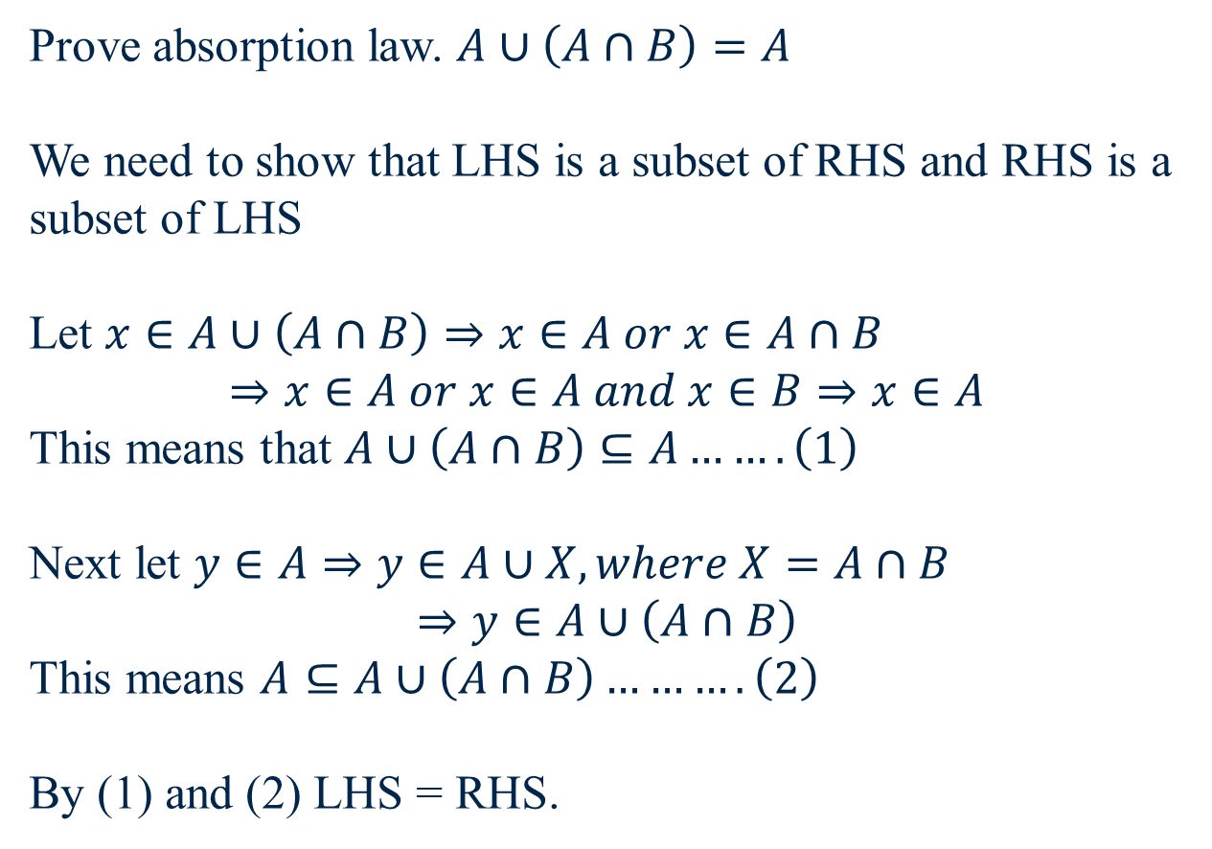

Slide 53

A
B

Slide 54
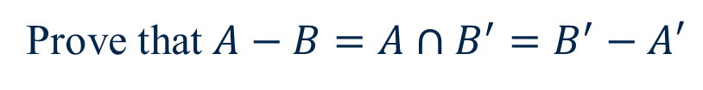

Slide 55
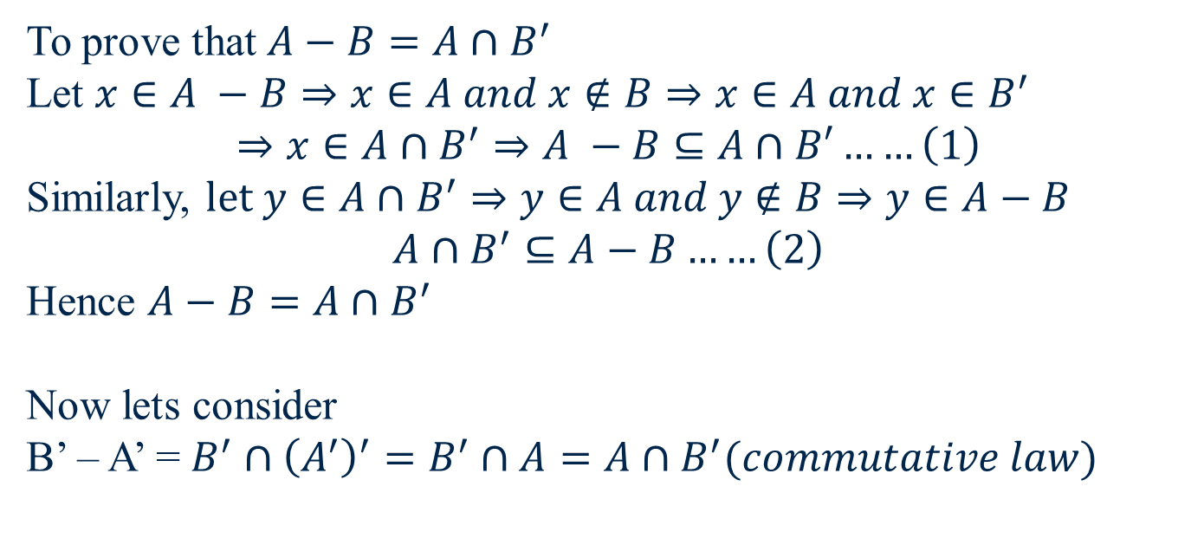

Slide 56
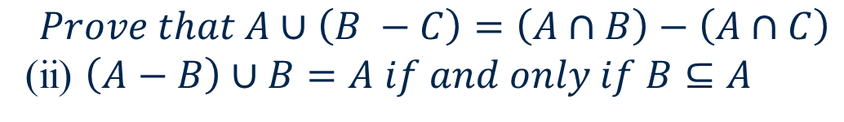

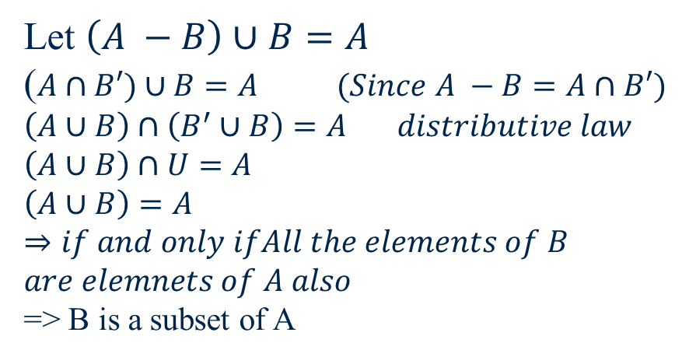
A
B

Slide 57
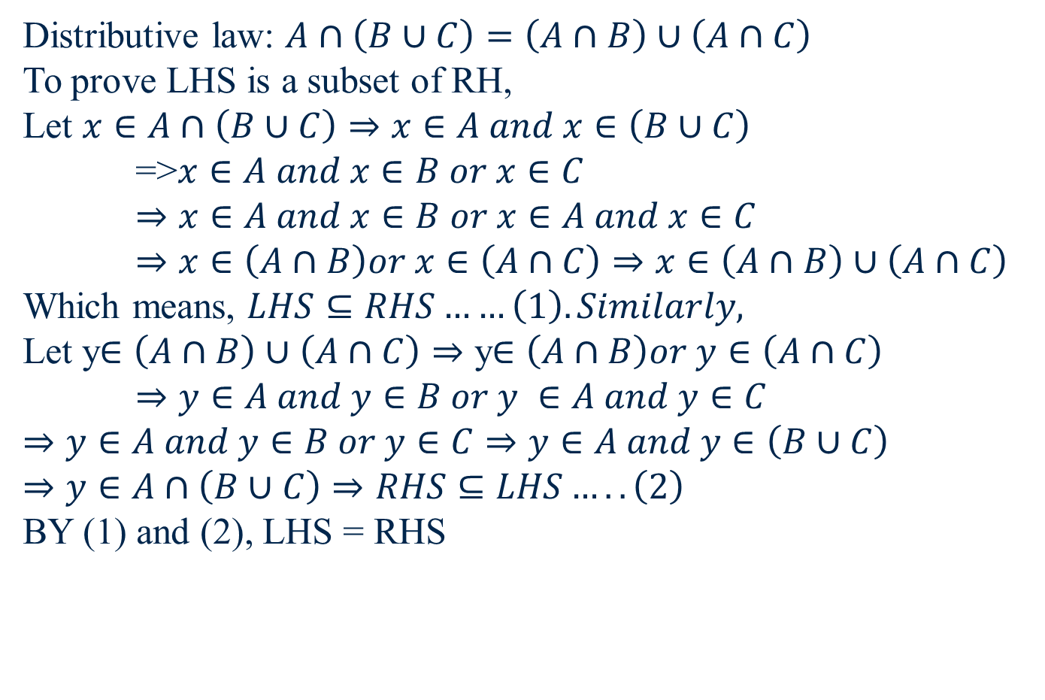

Slide 58
Set Partition
Definition. We say that a group of sets partitions another set if they are mutually exclusive and exhaustive with respect to that set. When we “partition a set,” we break it down into mutually exclusive and exhaustive regions, i.e., regions with no overlap. The Venn diagram below should help you get the picture. In this diagram, the set A (the rectangle) is partitioned into sets W,X, and Y.

Slide 59
Set Partition

Slide 60
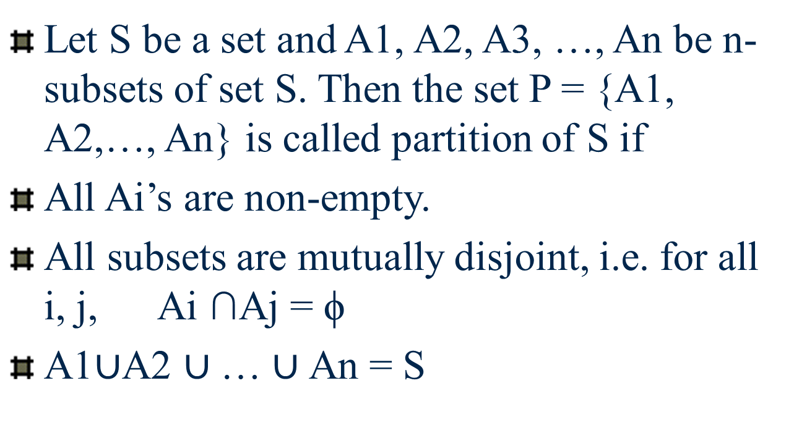
Set Partitions

Slide 61
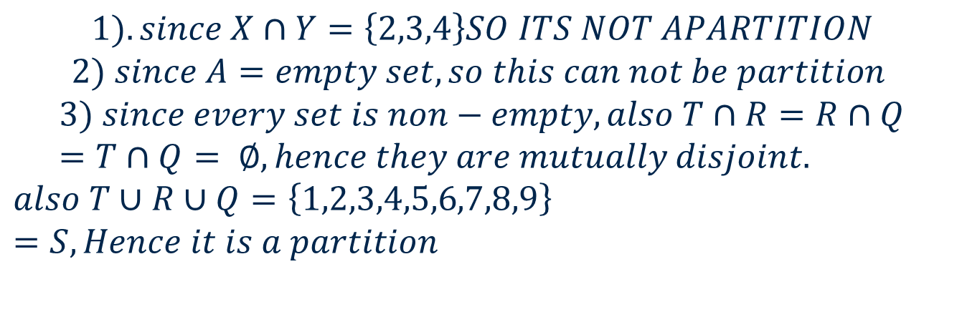
For set S = {1, 2, 3, 4, 5, 6, 7, 8, 9} which of the following are partition?
X = {2, 3,4}, Y = {1,2,3,4,5,9} Z = {4,6,7,8}
A= {}, B = {1,3,5,7,9} C = {2,4,6,8}
T = {1,3,4,5}, R = {2,6,9}, Q = {7,8}

Slide 62
Some Test Questions

Slide 63
Some Test Questions

Slide 64
Some Test Questions

Slide 65
Some Test Questions

Slide 66
Some Test Questions

Slide 67
Some Test Questions

Slide 68
Some Test Questions

Slide 69
Some Test Questions
ANS: - A

Slide 70
Some Test Questions
B
A
ANS:- B

Slide 71
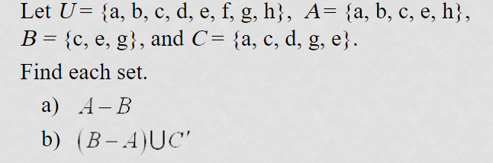

Slide 72
Ordered n-tuples
For n∈N, an ordered n-tuple or a sequence of length n is written (a₁, a₂, …, a_{n}). The first element is a₁, etc.
These are like sets, except that duplicates matter, and the order makes a difference. Note (1, 2) ≠ (2, 1) ≠ (2, 1, 1).
Empty sequence, singlets, pairs, triples, quadruples, quintuples, …, n-tuples.

Slide 73
Cartesian Products of Sets
For sets A, B, their Cartesian product A×B :≡ {(a, b) | a∈A ∧ b∈B }.
E.g. {a,b}×{1,2} = {(a,1),(a,2),(b,1),(b,2)}
Note that for finite A, B, |A×B|=|A||B|.
Note that the Cartesian product is not commutative: A×B ≠ B×A.
Extends to A₁ × A₂ × … × A_{n}...

Slide 74
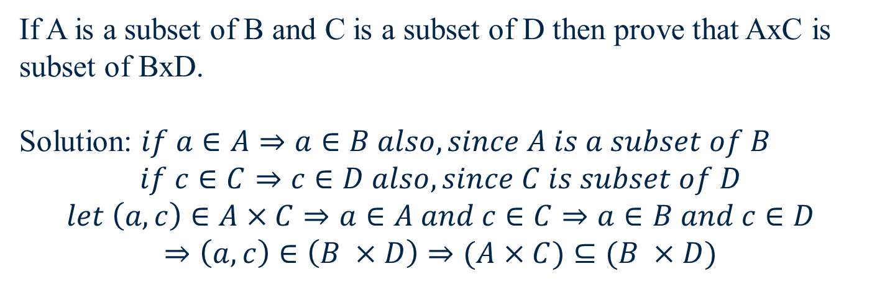
If A = {2,3,4} B = {p,q} then find A x B and B x A
Ans:
A x B = {(2, p), (2, q), (3, p), (3, q), (4, p), (4, q)}
B x A = {(p, 2), (p, 3), (p, 4), (q, 2), (q, 3), (q, 4)}

Slide 75
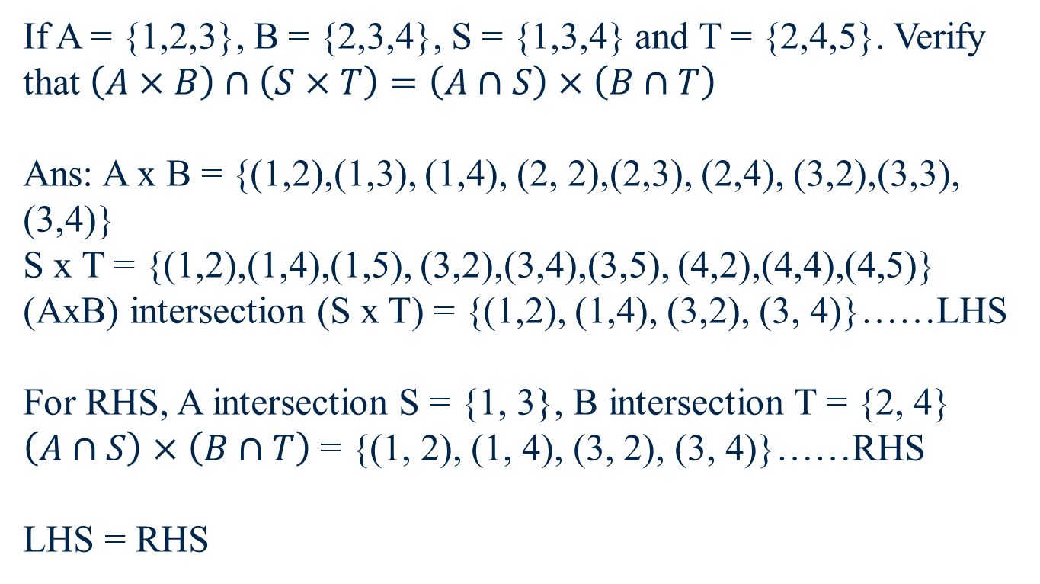

Slide 76
Tree diagram for Cartesian product
A
2
1
B
4
2
3
B
4

Slide 77
A = {1,2,3}, B = {2, 4, 5} and C = {a, b}
Find A x B x C = {(1,2, a), (1, 2, b), (1, 4, a),(1, 4, b), (1, 5, a), (1, 5, b), (2,2, a), (2, 2,b), (2, 4, a), (2, 4, b), (2, 5, a), (2, 5, b), (3, 2, a), (3, 2, b), (3, 4, a),(3, 4, b), (3, 5,a), (3, 5, b)}
2
1
a
4
2
b
5
3

Slide 78
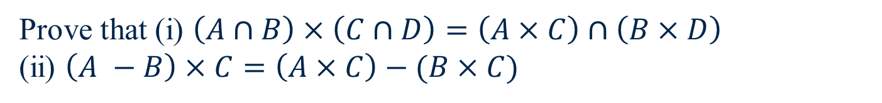
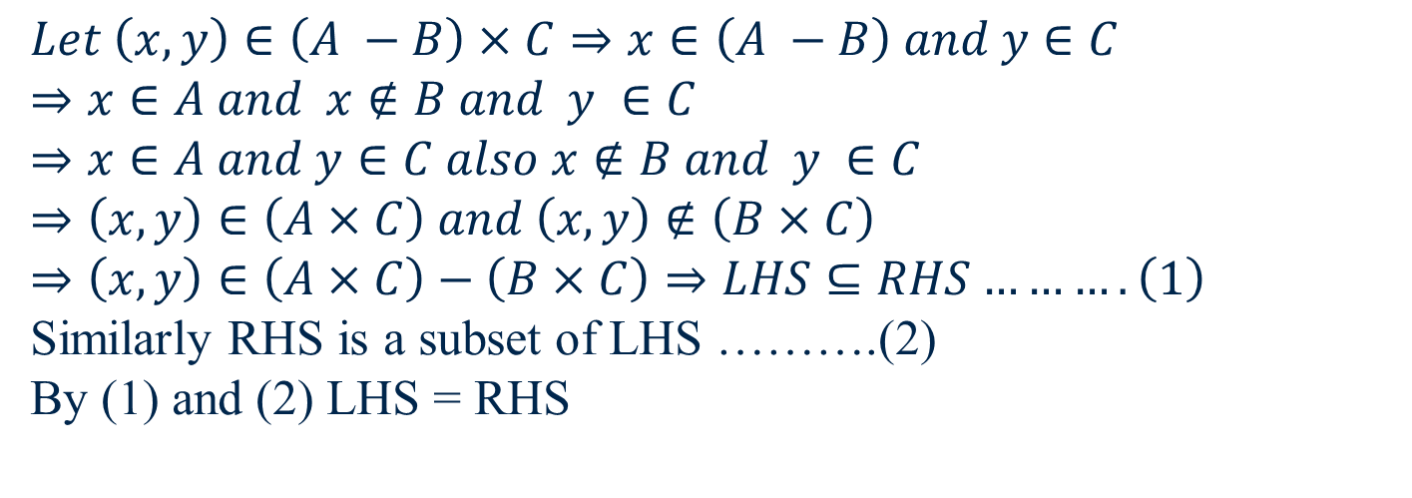

Slide 79
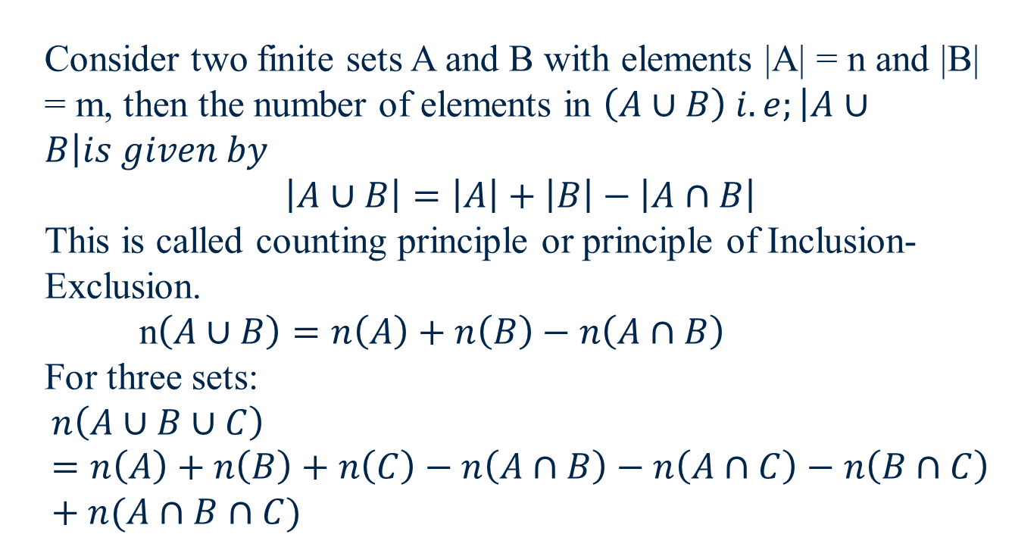
Application of Set Theory

Slide 80
B
A
A U B

Slide 81
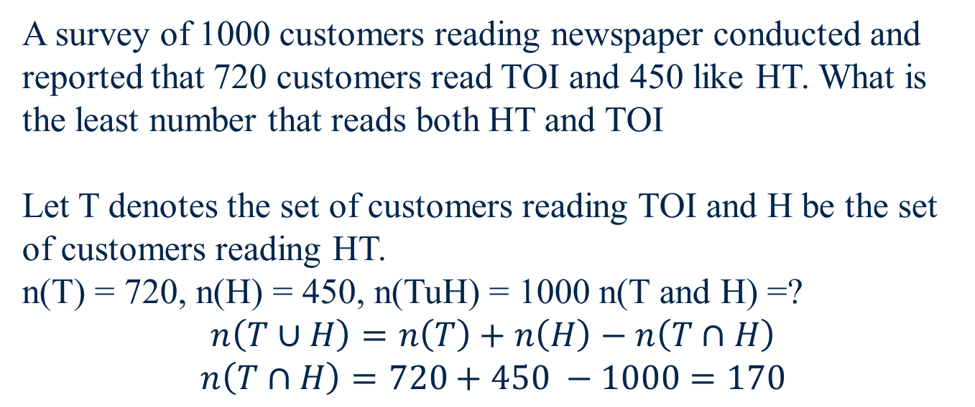
Examples

Slide 82
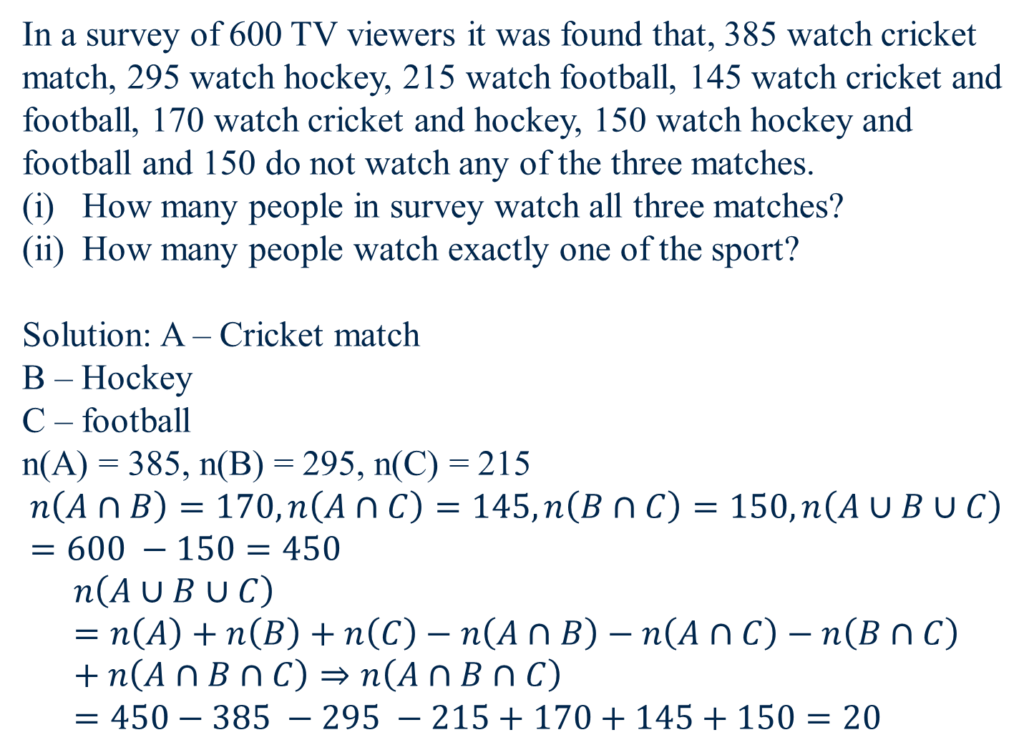

Slide 83

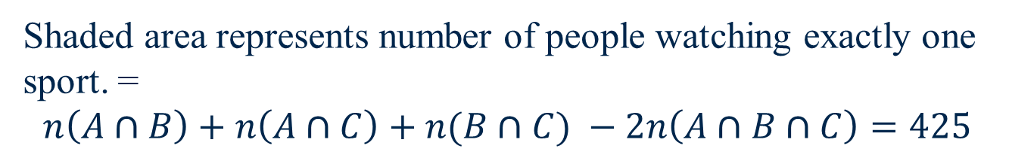
A
150
B
C
Union – 425 = 450 – 425 = 25 people watch exactly one sport

Slide 84
A survey of 500 TV viewers gives the following information:
285 watch Aaj Tak
195 watch NDTV
115 watch ZEE
45 watch Aaj Tak and Zee
70 watch Aaj Tak and NDTV
50 watch NDTV and Zee
50 do not watch any from these three
Calculate the number of viewers who watch all of the three news channel. (Ans. 20)
Also calculate the number of viewers watching exactly one news channel. (Ans. 325)

Slide 85

70
500
A
285
N
195
95
190
50
50
20
30
25
40
50
45
Z
115

Slide 86
Out of 150 students who appeared in an examination, 100 passed in physics, 120 in chemistry and 80 in biology. 85 students passed in both physics and chemistry, 70 passed in both chemistry and biology, 60 in both biology and physics and 60 passed in all three subjects. Find the no. of students who
Failed in all three subjects. = 5
Passed in only one subject and = 50
Passed in physics and chemistry but failed in biology. = 25

Slide 87
P and C = 25
P
C
25
15
P and B and C =60
Only(P and B) = 0
Only(B and C) = 10
10
B
No. of fail students = U – n(AUBUC) 150 – 145 = 5

Slide 88
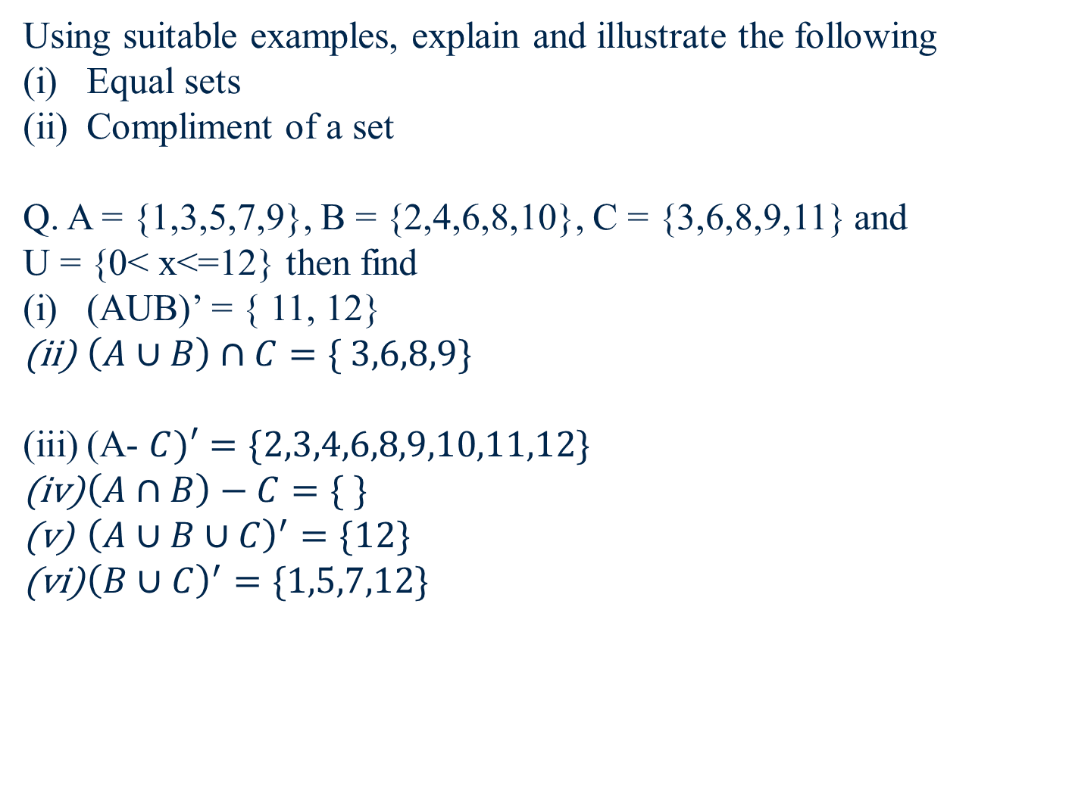

Slide 89
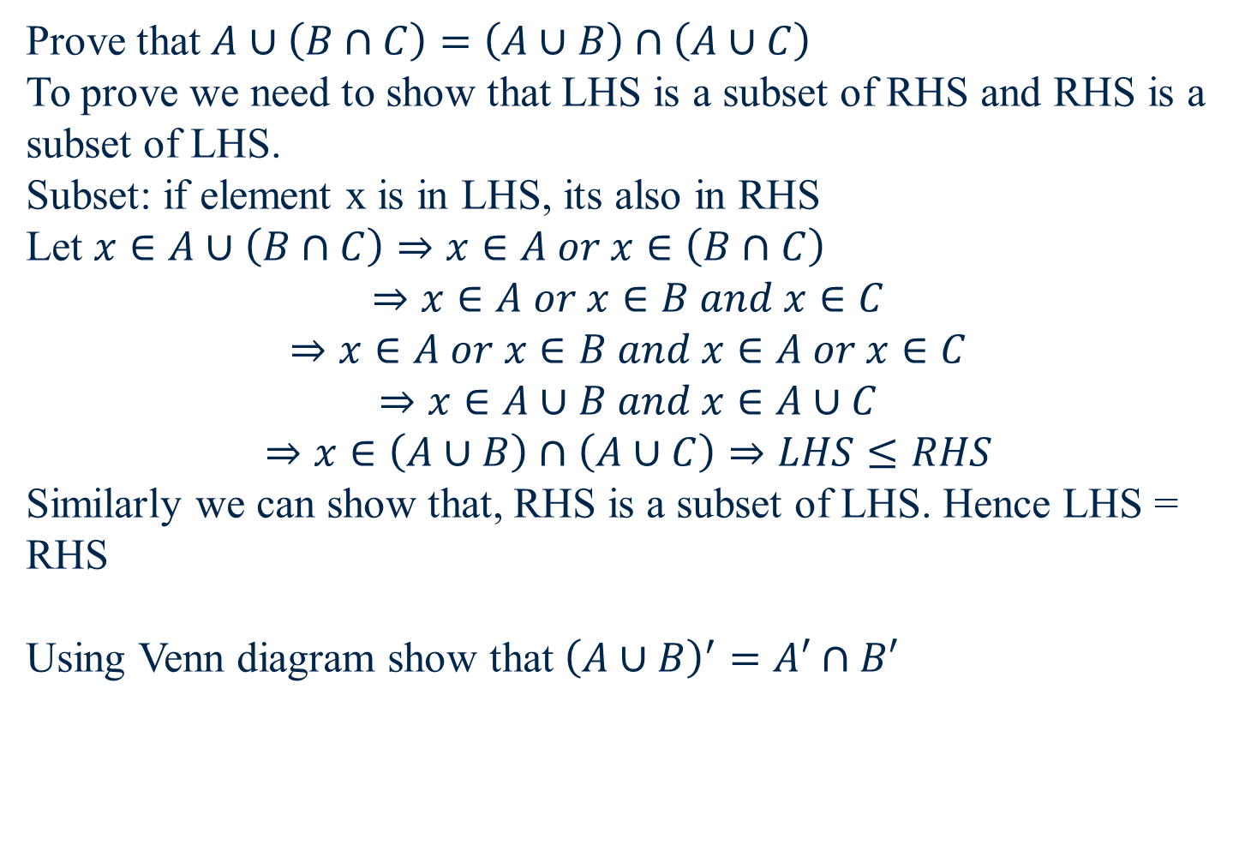

Slide 90
In a survey conducted to know people’s preference for android phones and I phones, 80 person preferred android phones while 60 person preferred I phones. There were 20 who liked both and may prefer any. If there was no one who didn’t prefer at least one of the phones, then on how many people was the survey conducted?
n(A) = 80, n(B) = 60, n(AandI) = 20, n(AUB) = 80+60-20=120

Slide 91
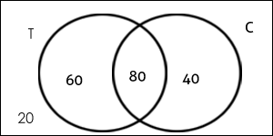
In a college, 200 students are randomly selected. 140 like tea, 120 like coffee and 80 like both tea and coffee.
How many students like only tea?
How many students like only coffee?
How many students like neither tea nor coffee?
How many students like only one of tea or coffee?
How many students like at least one of the beverages?

Slide 92
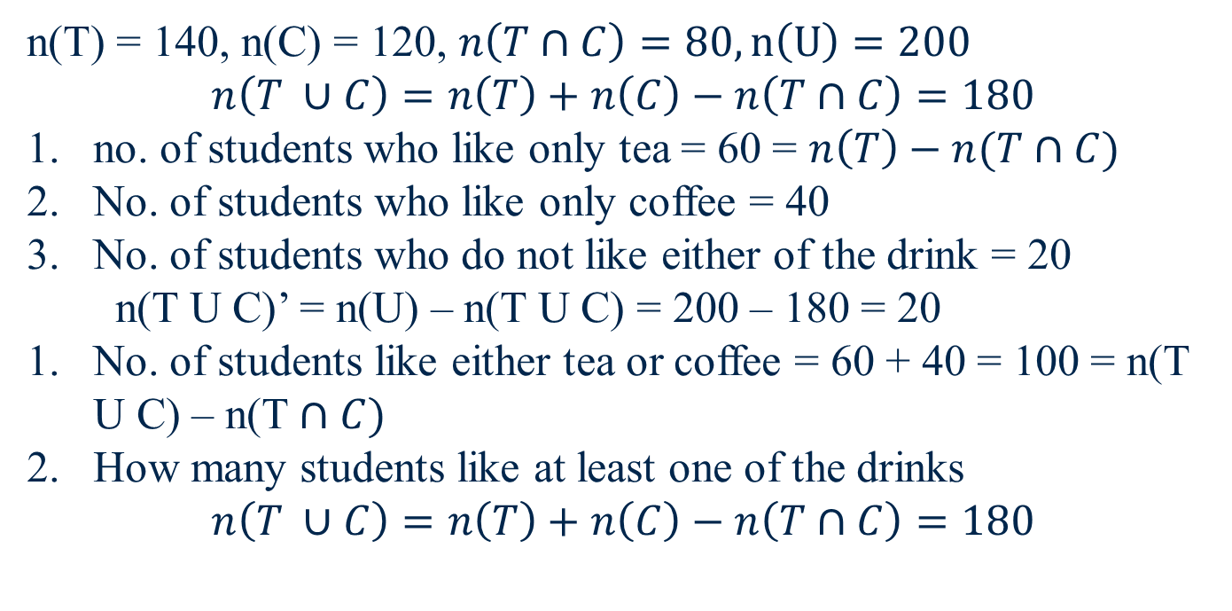

Slide 93
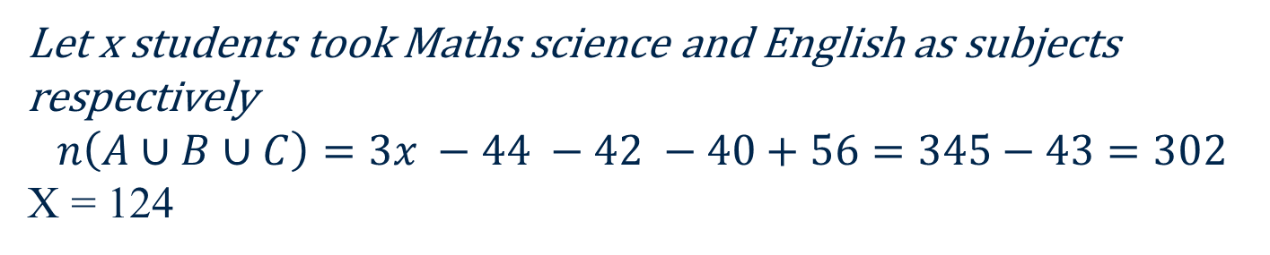
In a class of 345 students, the students who took English, Math and Science are equal in number. There are 30 students who took both English and Math, 26 who took both Math and Science, 28 who took Science and English and 14 who took all the 3 subjects. There are 43 students who didn’t take any of the subjects. Answer the following question according to the data given above.
How many students have taken English as a subject? How many students have taken only one subject? = 80+82+84 = 246

Slide 94
E
M
X – 44 = 80
16
X – 42 = 82
14
14
12
43
X – 40 = 84
S
X = 124

Slide 95
At a certain conference of 100 people there are 29 Indian women and 23 Indian men. Out of these Indian people 4 are doctors and 24 are either men or doctors. There are no foreign doctors. Find the number of women doctors attending the conference.
Set M – male Indians
Set D – Indian doctors
n(M) = 23
n(D) = 4
n(MUD) = 24
n(M∩D)=? = n(MUD) – n(M) – n(D) =3
There are 3 Indian male doctors attending the conference. But there are total 4 Indian doctors attending the conference, hence 4 – 3 = 1 woman Indian doctor is attending the conference

Slide 96
In a town 85% of the people speak Tamil, 40% speak English and 20% speak Hindi. Also 32% speak Tamil and English, 13% speak Tamil and Hindi and 10% speak English and Hindi, find the percentage of people who can speak all the three languages.

Slide 97
In a survey of 500 students of a college, it was found that 49% liked watching football, 53% liked watching hockey and 62% liked watching basketball. Also, 27% liked watching football and hockey both, 29% liked watching basketball and hockey both and 28% liked watching football and basket ball both. 5% liked watching none of these games.
How many students like watching all the three games? = 75
Find the ratio of number of students who like watching only football to those who like watching only hockey. = 3:4
Find the number of students who like watching only one of the three given games. = 205
Find the number of students who like watching at least two of the given games. = 270

Slide 98
n(F) = percentage of students who like watching football = 49% n(H) = percentage of students who like watching hockey = 53% n(B)= percentage of students who like watching basketball = 62% n ( F ∩ H) = 27% ; n (B ∩ H) = 29% ; n(F ∩ B) = 28% Since 5% like watching none of the given games so, n (F ∪ H ∪ B) = 95%. Now applying the basic formula, 95% = 49% + 53% + 62% -27% - 29% - 28% + n (F ∩ H ∩ B) Solving, you get n (F ∩ H ∩ B) = 15%.
Now, make the Venn diagram as per the information given.

Slide 99
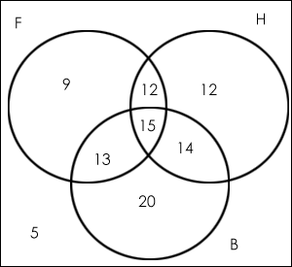
Number of students who like watching all the three games = 15 % of 500 = 75.
Ratio of the number of students who like only football to those who like only hockey = (9% of 500)/(12% of 500) = 9/12 = 3:4.
The number of students who like watching only one of the three given games = (9% + 12% + 20%) of 500 = 205
The number of students who like watching at least two of the given games=(number of students who like watching only two of the games) +(number of students who like watching all the three games)= (12 + 13 + 14 + 15)% i.e. 54% of 500 = 270.

